Slide 1

Choosing the most appropriate district for starting a Multiplex in The Most Densely Populated District of Tamilnadu, India
Meenakshi S Arya

Slide 2
Background
TamilNadu is one of the most popular states in the South India as it is the homeground of the Tamil movie industry, popularly known as “Tollywood”.
People in Tamilnadu are extremely fond of watching movies and dining out.
Thus, it is an opportune candidate for setting up a Multiplex with movie theatres and eating joints.
These multiplexes are great business ideas as they provide a one-stop solution to all the needs of customers, ranging from household groceries, to beauty products to dining options to options for entertainment.

Slide 3

Problem Statement
Tamilnadu majorly comprises of 37 districts however, the population of a district will determine the feasibility of starting a new multiplex at a given location.
The project aims to predict which district will be most suitable for the same considering the overall population and the number of eating joints and multiplexes in a given district.
The battle of these neighborhoods will be unrevealed in a detailed manner in the subsequent parts of the implementation.

Slide 4
Dataset Description
The dataset available in wikipedia for districts of Tamilnadu will be used for obtaining the relevant information about the various districts in Tamilnadu, their area, population and talukas within each district.
This data along with Foursquare location data will be used for obtaining the information about the number of multiplexes in the most populous districts of Tamilnadu.

Slide 5
Flow of the process
Web Scrapping
Data Cleaning and Formatting
Feature Selection
Obtaining the coordinates of Tamil Nadu using Geopy
Obtaining District Coordinates

Slide 6
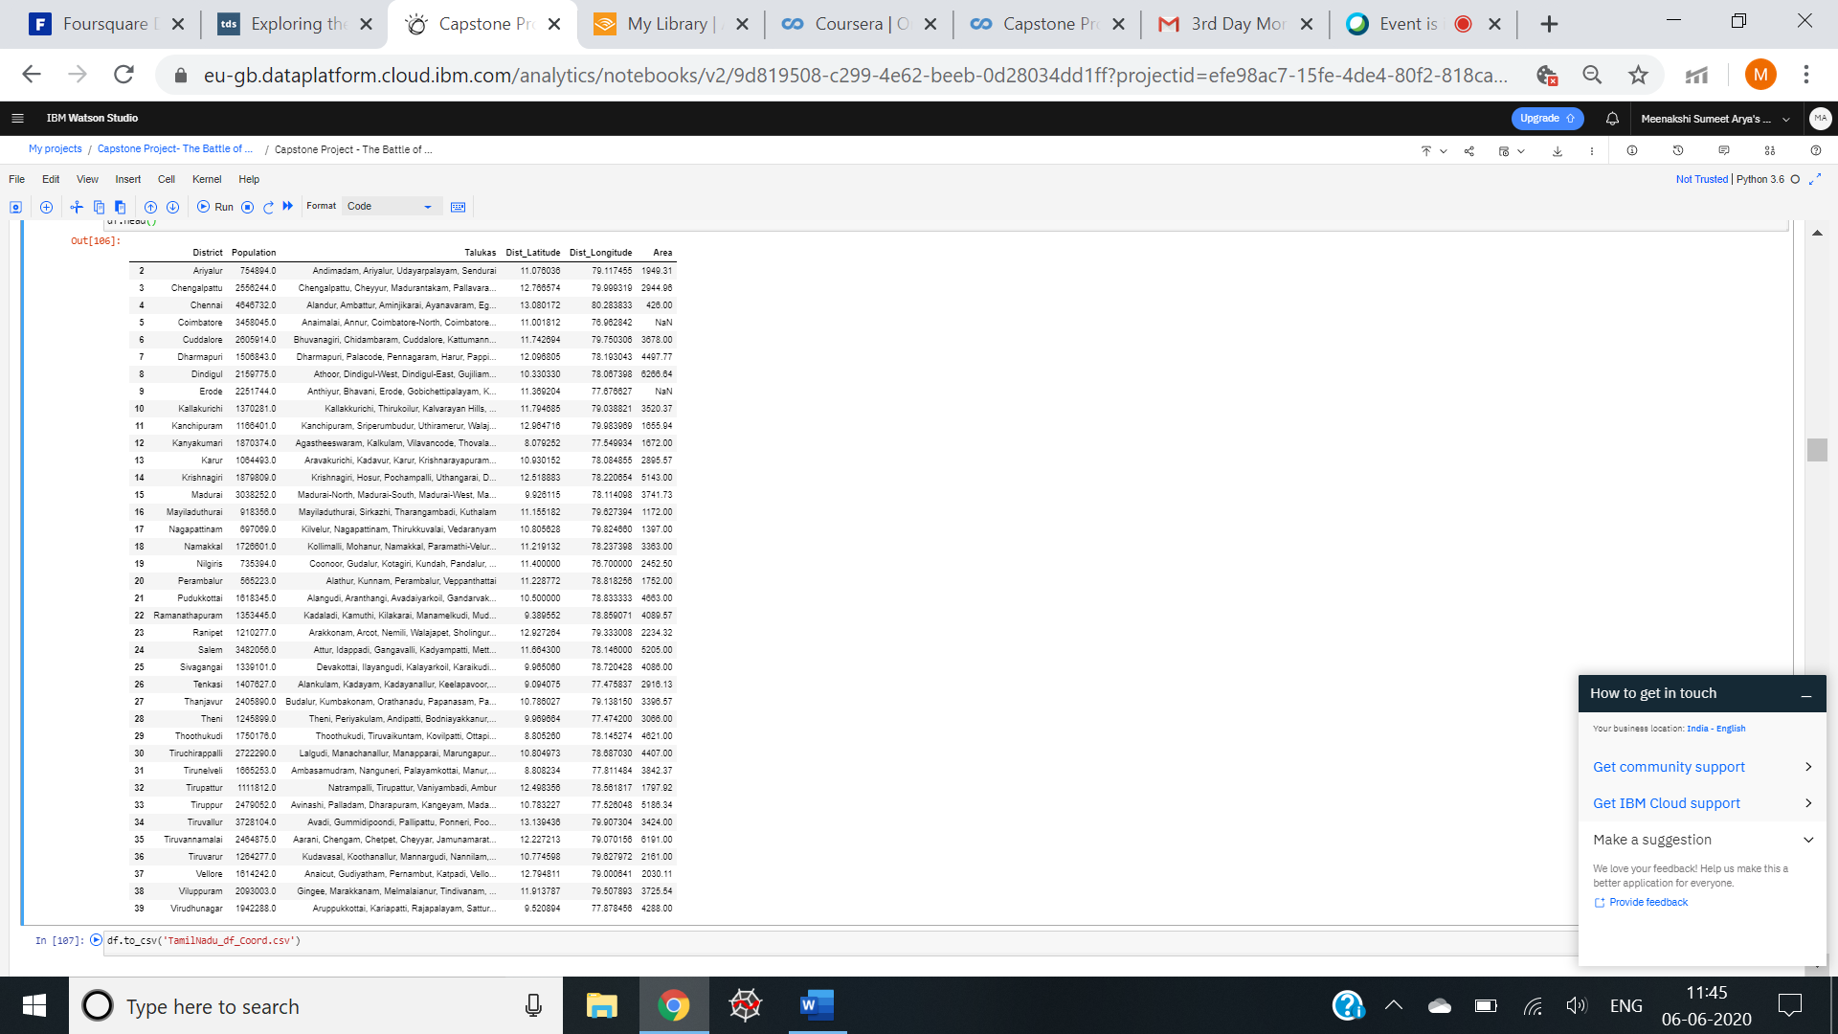
The final look of the dataset

Slide 7
Using Foursquare API to explore Tamil Nadu for the number of multiplexes in the top 5 most populated districts

Slide 8
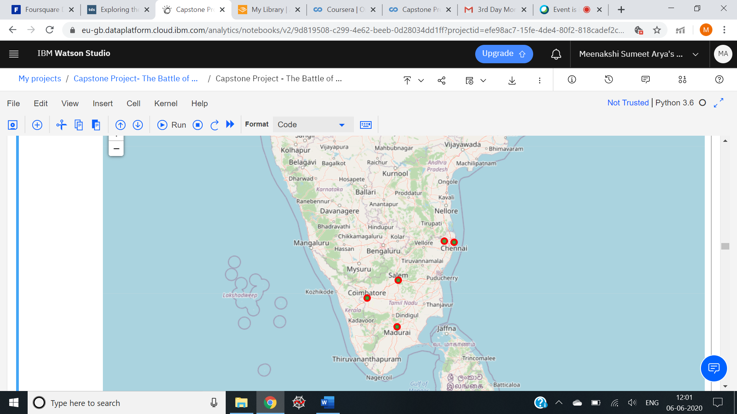
The five most populous districts visualized

Slide 9
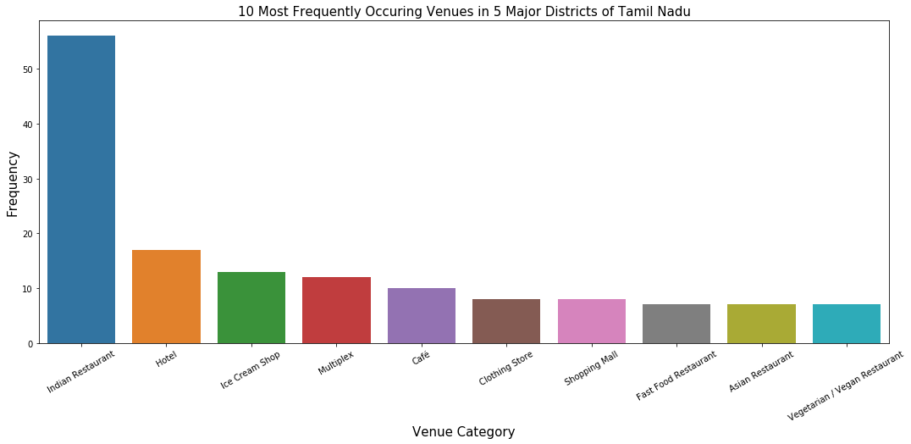
Exploring the most popular venues in 5 topmost districts

Slide 10
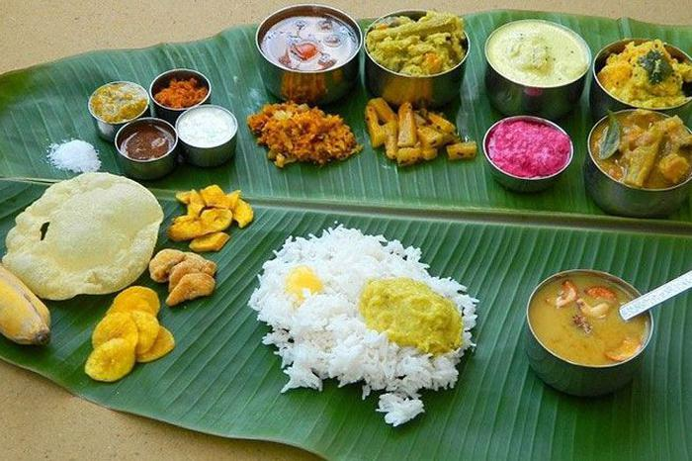
The winner is Indian Restaurants
A typical south Indian thali

Slide 11
Obtaining information about the top 5 venues of each district
Create a data-frame with pandas one hot encoding for the venue categories
Use pandas groupby on District column and obtain the mean.
Transpose the data-frame at and arrange in descending order.

Slide 12
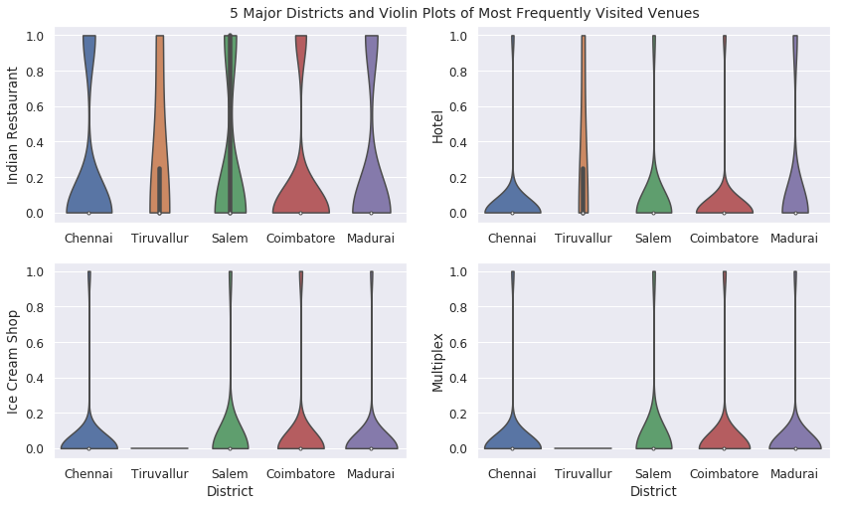
Plot of most frequently Visited Venues in Top 5 Districts

Slide 13
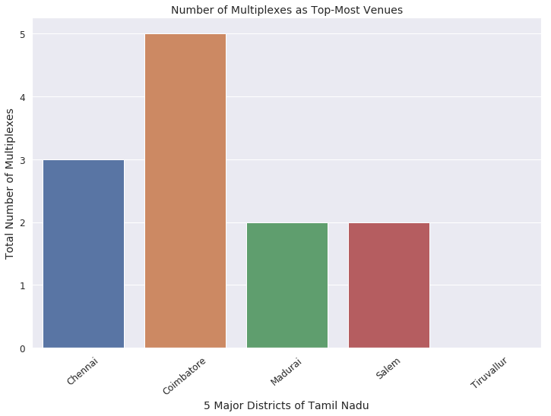
Number of Multiplexes as Top Venues in Topmost 5 Districts

Slide 14
Using K-Means Clustering for clustering the Tamil Nadu Districts (Neighborhoods)

Slide 15
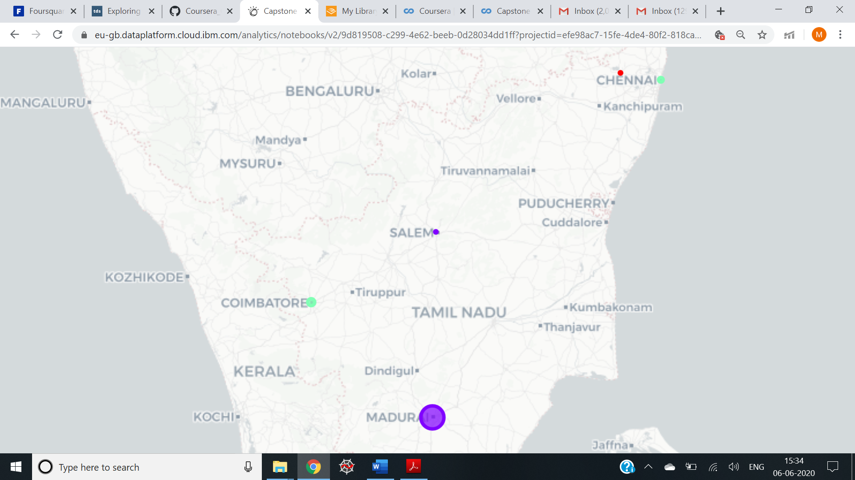
Coimbatore maximum number of multiplexes (green cluster), Chennai (red cluster) followed by Madurai and Salem having same number of multiplexes (purple cluster).

Slide 16
Results and Discussion
Indian restaurants top the charts of most common venues in the 5 districts.
Coimbatore district has the maximum number of multiplexes as the most popular venues.
Despite being thickly populated, Tiruvallur does not have any multiplex whereas this district has the maximum number of Indian restaurants.
Tiruvallur district is the most appropriate district for opening a new multiplex to provide people with a weekend getaway and an avenue to watch movies as well as eat out.

Slide 17
Conclusion
The project was a real hands-on experience for applying the concepts of software engineering.
Right from the conceptualizing of the idea to executing it and then finally drawing conclusions from it for a major business decision has really been informative.
Scrapping data from the web, cleaning it and then applying various visualization tools to it so that it can make sense and communicate the information required was really a great learning experience.
Also it helped in understanding the usage of some frequently used python libraries to scrap web-data, Foursquare API to explore the major districts of Tamil Nadu and visualizing the results of segmentation of districts using Folium leaflet map.
Since the entire analysis was mostly concentrated on the possibilities of opening a multiplex targeting the fact that people are fond of going out and eating out, some of the results obtained are contrary to what the expectations were.
Finally to conclude this project provided a true glimpse of how real life data-science projects look like
Potential for this kind of analysis in a real-life business problem is discussed in great detail.

Slide 18
Thank you!!!!!

